Slide 1
NYSE Analysis With MySQL
Ethan Graham, Scott Gozdzialski, Huynh Vu
Graduate Students Master of Data Science
Southern Methodist University
Dallas, Texas
Github link
https://github.com/DSSMU/MSDS7330_Project

Slide 2
NYSE Securities Analysis With MySQL
Initial plan: https://cran.rstudio.com/web/packages/stocks/index.html
Utilities, but no actual data
Better Plan: https://www.kaggle.com/benjibb/lstm-stock-prediction-20170507/data
NYSE DATA FROM 2010-2016

Slide 3
Data
The data consists New York Stock Exchange data from 2010 to 2016. It is made up of four files.
Prices.csv - Raw daily stock prices 50.4MB
Prices-split-adjusted.csv – adjustment for and stock splits 51.4MB
Securities.csv – descriptions of the companies and different sectors 60KB
Fundamentals.csv – SEC 10K filings for each company 1.3MB
This data was used in a SQL database on two Mac machines running the SQL server on Bluemix and one Windows 10 Machine running SQLite3.

Slide 4
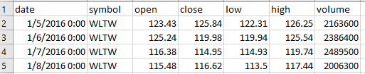
Data
Prices.csv - Raw daily stock prices 50.4MB
Prices-split-adjusted.csv – adjustment for and stock splits 51.4MB
The heading for Prices.csv and Prices-Split.csv are Date, Symbol, Open, Close, Low, High, and Volume
Example below.

Slide 5
Data
Securities.csv – descriptions of the companies and different sectors 60KB
The heading for Securities.csv are Ticker Symbol, Security, SEC filings, GICS Sector, GICS Sub Industry, Address of Headquarter, Date first added, CIK
Fundamentals.csv – SEC 10K filings for each company
The headings for fundamentals is ID, Ticker Symbol, Period Ending, Accounts Payable, Add’l income/expense items, After tax ROE, Capital Expenditures, Capital surplus, Cash Ratio, cash and Cash equivalents Changes in Inventories, Common Stocks, Cost of revenue, Current ratio, deferred Asset Charges, Deferred Liability Charges, Depreciation, earnings Befroe Interest and tax, Earning Before tax….and 61 others covering all Net, Gross, and Tax Expendature, Revenue, or Liability.
These files take up to much screen to display an example below.

Slide 6
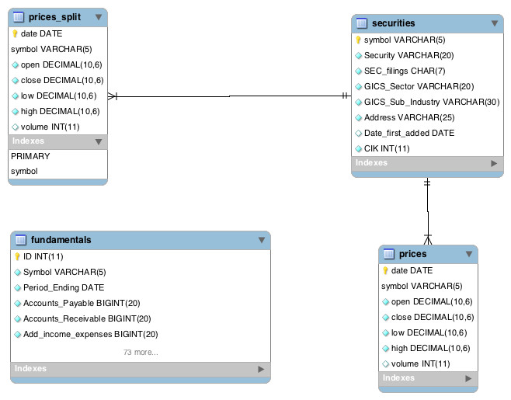
MYSQL DATABASE
The Data was put into an SQL Database with the Ticker Symbol as the unifying key.
Relation shown below

Slide 7
MYSQL DATABASE DDL example
CREATE TABLE securities
(
symbol VARCHAR(5) PRIMARY KEY,
Security VARCHAR(20) NOT NULL,
SEC_filings CHAR(7) NOT NULL,
GICS_Sector VARCHAR(20) NOT NULL,
GICS_Sub_Industry VARCHAR(30) NOT NULL,
Address VARCHAR(25) NOT NULL,
Date_first_added DATE,
CIK INT NOT NULL
);
The entire DDL structure is located in the github link displayed on the first slide

Slide 8
MYSQL DATABASE DML example
use stocks;
LOAD DATA LOCAL INFILE '/Users/Ethan/Desktop/nyse/securities.csv' INTO TABLE securities
FIELDS TERMINATED BY ',' ENCLOSED BY '"' IGNORE 1 LINES;
LOAD DATA LOCAL INFILE '/Users/Ethan/Desktop/nyse/prices.csv' INTO TABLE prices
FIELDS TERMINATED BY ',' IGNORE 1 LINES;
CREATE OR REPLACE VIEW assets AS
SELECT avg(Total_Assets) as Assets, symbol FROM
fundamentals Group By symbol ORDER BY Assets DESC LIMIT 10;
The entire DML structure is located in the github link displayed on the first slide

Slide 9
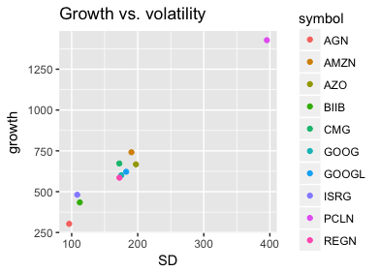
Insight 1
Is there a relationship between stock growth and volatily?
We use prices-split-adjusted to account for changes of
Stock value based on splits. We use the standard
deviation of the stock as a measure of volatity.
SELECT * FROM
(
SELECT symbol, max(high)-min(low) AS growth
FROM prices_split
GROUP BY symbol
) AS subTable ORDER BY growth ASC LIMIT 1;

